Slide 1
Software Testing

Slide 2
Testing is intended to show that a program does what it is intended to do and to discover program defects before it is put into use.
The testing process has two distinct goals
To demonstrate to the developer and the customer that the software meets its requirements. → validation
To discover situations in which the behavior of the software is incorrect, undesirable, or does not conform to its specification → finding defects

Slide 3
Validation and Verification
Testing is part of a broader process of software verification and validation (V & V)
Validation: Are we building the right product?’
Verification: Are we building the product right?
The aim of verification is to check that the software meets its stated functional and non-functional requirements.

Slide 4
Validation and Verification
The aim of validation is to ensure that the software meets the customer’s expectations.
The ultimate goal of verification and validation processes is to establish confidence that the software system is ‘fit for purpose’.

Slide 5
Validation and Verification
This means that the system must be good enough for its intended use.
As software testing, the verification and validation process may involve software inspections and reviews

Slide 6
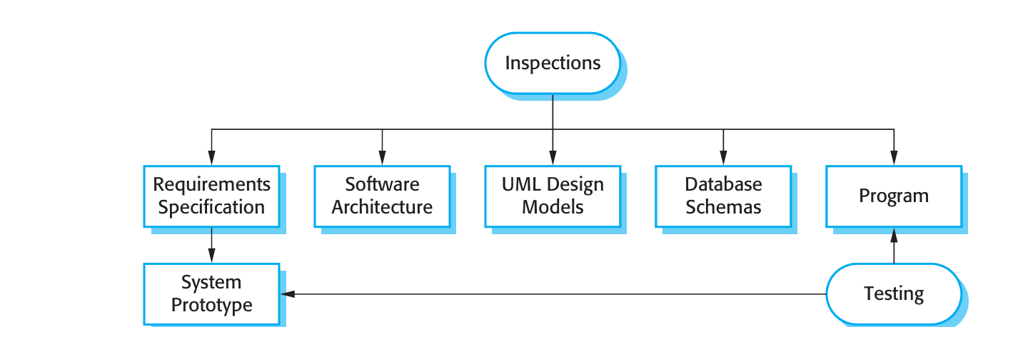
Inspection and Testing

Slide 7
Inspection and Testing
There are three advantages of software inspection over testing:
During testing, errors can hide other errors.
Incomplete versions of a system can be inspected without additional costs.
While searching for program defects, an inspection can also consider broader quality attributes of a program, such as compliance with standards, portability, and maintainability.

Slide 8
Inspection and Testing
inspections are more effective for defect discovery than program testing.
inspections cannot replace software testing.
Inspections are not good for discovering defects that arise because of unexpected interactions between different parts of a program, timing problems, or problems with system performance.

Slide 9
Software testing process

Slide 10
Software Testing Process
Three stages of testing
Development Testing
Release Testing
User Testing

Slide 11
Software testing process
Manual
Automatic
In practice, the testing process usually involves a mixture of manual and auto mated testing.

Slide 12
Development Testing
Where the system is tested during development to discover bugs and defects.
System designers and programmers are likely to be involved in the testing process
Some development processes use programmer/tester pairs.
For critical systems, a separate testing group within the development team.

Slide 13
Development Testing
During development, testing may be carried out at three levels
Unit Testing
Component Testing
System Testing

Slide 14
Unit Testing
Unit testing, where individual program units or object classes are tested.
Unit testing should focus on testing the functionality of objects or methods.
When testing object classes, you should design your tests to provide coverage of all of the features of the object.

Slide 15
Unit testing
test all operations associated with the object
set and check the value of all attributes associated with the object
put the object into all possible states.

Slide 16
Choosing unit test cases
Testing is expensive and time consuming, so it is important that you choose effective unit test cases
Possible strategy for choosing unit test cases.
Partition testing:
where you identify groups of inputs .
You should choose tests from within each of these groups.

Slide 17
Unit Testing
Guideline-based testing
where you use testing guidelines to choose test cases.
These guidelines reflect previous experience of the kinds of errors that programmers often make when developing components

Slide 18
Component Testing
During component testing several individual units are integrated to create composite components.
Component testing should focus on testing component interfaces.
Assume that components A, B, and C have been integrated to create a larger component or subsystem.

Slide 19
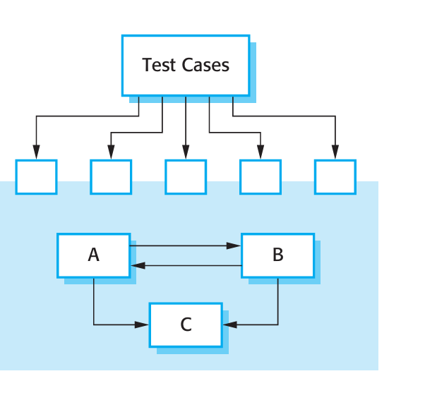
Component Testing

Slide 20
Component Testing
The problem, of course, is "putting them together interfacing
Data can be lost across an interface
one module can have adverse affect on another
sub functions, when combined, may not produce the desired major function
Individually acceptable error may be magnified to unacceptable levels
Global data structures can present problems.

Slide 21
System testing
Some or all of the components in a system are integrated and the system is tested as a whole.
System testing should focus on testing component interactions

Slide 22
System Testing
System testing checks that components are compatible, interact correctly and transfer the right data at the right time across their interfaces.
It obviously overlaps with component testing but there are two important differences

Slide 23
System Testing
1. During system testing, reusable components that have been separately developed and off-the-shelf systems may be integrated with newly developed components. The complete system is then tested.
2. Components developed by different team members or groups may be integrated at this stage.
System testing is a collective rather than an individual process.

Slide 24
Release Testing
Release testing is the process of testing a particular release of a system that is intended for use outside of the development team.

Slide 25
Release Testing
There are two important distinctions between release testing and system testing during the development process:
1. A separate team that has not been involved in the system development should be responsible for release testing.
2. The objective of release testing is to check that the system meets its requirements and is good enough for external use (validation testing).

Slide 26
Requirements-based testing
A general principle of good requirements engineering practice is that requirements should be testable.
Requirements-based testing, therefore, is a systematic approach to test case design where you consider each requirement and derive a set of tests for it

Slide 27
Requirements-based testing is validation rather than defect.

Slide 28
Scenario testing is an approach to release testing where you devise typical scenarios of use and use these to develop test cases for the system.
A scenario is a story that describes one way in which the system might be used.

Slide 29
Scenarios should be realistic and real system users should be able to relate to them

Slide 30
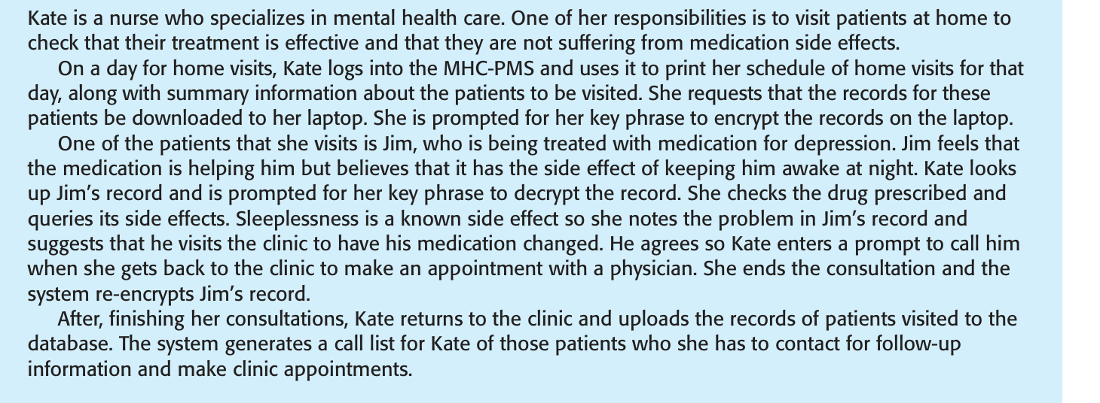

Slide 31
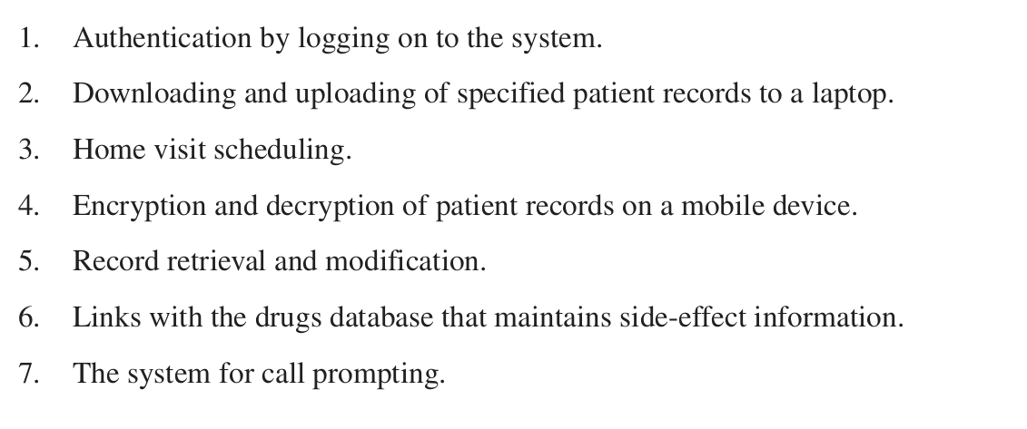

Slide 32
Performance Testing
Once a system has been completely integrated, it is possible to test for emergent properties, such as performance and reliability.
Performance tests have to be designed to ensure that the system can process its intended load.
This usually involves running a series of tests where you increase the load until the system performance becomes unacceptable.

Slide 33
User Testing
users or customers provide input and advice on system testing.
Different types of system testing are:-
Alpha testing, where users of the software work with the development team to test the software at the developer’s site.
Beta testing, where a release of the software is made available to users to allow them to experiment and to raise problems that they discover with the system developers

Slide 34
3. Acceptance testing is an inherent part of custom systems development. It takes place after release testing.
It involves a customer formally testing a system to decide whether or not it should be accepted from the system developer.
Acceptance implies that payment should be made for the system.
There are six stages in the acceptance testing process,.

Slide 35
Acceptance Test Criteria
Define acceptance criteria
Plan acceptance testing
Derive acceptance tests
Run acceptance tests
Negotiate test results
Reject/accept system

Slide 36
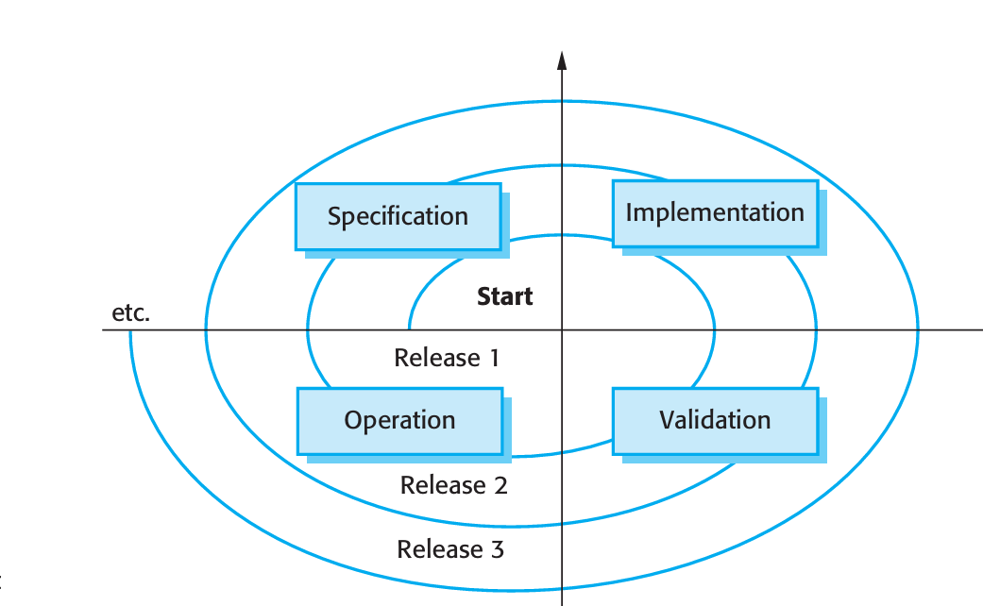
Software Evolution

Slide 37
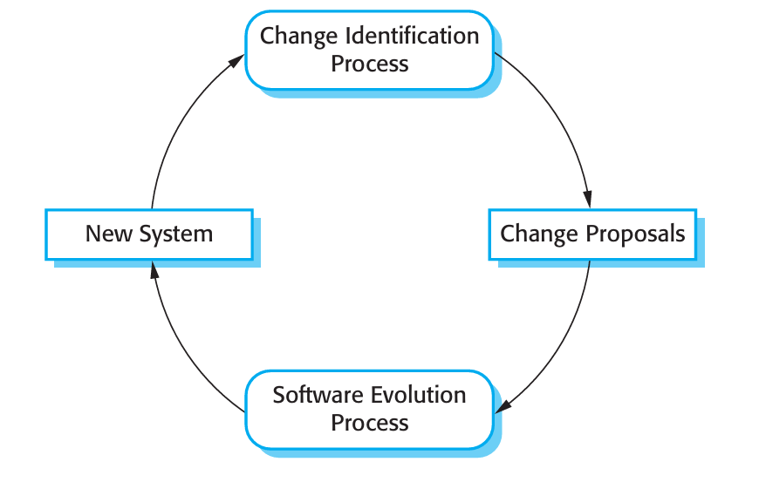
Software change

Slide 38
Software evolution
Software evolution processes vary depending on the type of software being maintained, the development processes used in an organization and the skills of the people involved.
In some organizations, evolution may be an informal process where change requests mostly come from conversations between the system users and developers.
In other companies, it is a formalized process with structured documentation produced at each stage in the process.

Slide 39
System change proposals are the driver for system evolution in all organizations.
Change proposals may come from existing requirements that have not been implemented in the released system, requests for new requirements, bug reports from system stakeholders, and new ideas for software improvement from the system development team.
The processes of change identification and system evolution are cyclic and continue throughout the lifetime of a system

Slide 40
Change proposals should be linked to the components of the system that have to be modified to implement these proposals.
This allows the cost and the impact of the change to be assessed. This is part of the general process of change management,

Slide 41
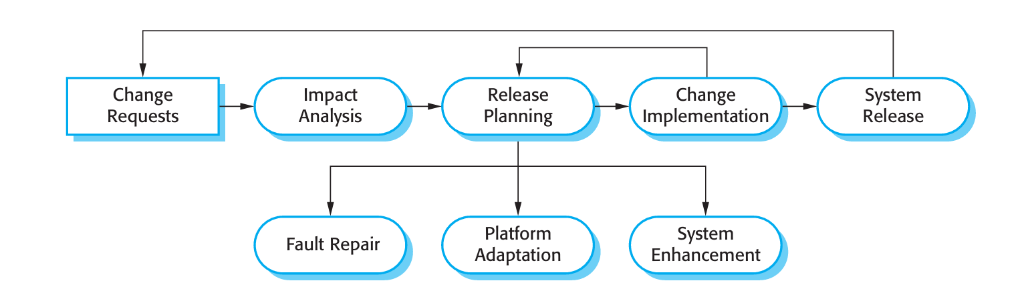
Software evolution process

Slide 42
Software Maintenance
Software maintenance is the general process of changing a system after it has been delivered.
The term is usually applied to custom software in which separate development groups are involved before and after delivery.

Slide 43
Software Maintenance
The changes made to the software may be simple changes to correct coding errors, more extensive changes to correct design errors, or significant enhancements to correct specification errors or accommodate new requirements.
Changes are implemented by modifying existing system components and, where necessary, by adding new components to the system.
There are three different types of software maintenance

Slide 44
Fault Maintenance
Environmental Adaptation
Functionality Addition

Slide 45
Fault repairs
1. Fault repairs Coding errors are usually relatively cheap to correct; design errors are more expensive as they may involve rewriting several program components.
Requirements errors are the most expensive to repair because of the extensive system redesign which may be necessary.

Slide 46
Environmental Adaptation
Environmental adaptation This type of maintenance is required when some aspect of the system’s environment such as the hardware, the platform operating system, or other support software changes.
The application system must be modified to adapt it to cope with these environmental changes.

Slide 47
Functionality addition
Functionality addition
This type of maintenance is necessary when the system requirements change in response to organizational or business change.
The scale of the changes required to the software is often much greater than for the other types of maintenance

Slide 48
Types of Maintenance
These types of maintenance are generally recognized but different people some times give them different names.
Corrective maintenance is universally used to refer to maintenance for fault repair.
Adaptive maintenance sometimes means adapting to a new environment and sometimes means adapting the software to new requirements

Slide 49
Types of Maintenance
Perfective maintenance sometimes means perfecting the software by implementing new requirements; in other cases it means maintaining the functionality of the system but improving its structure and its performance.

Slide 50
Software reengineering
older legacy systems are difficult to understand and change.
The programs may have been optimized for performance or space utilization at the expense of understandability, or, over time, the initial pro gram structure may have been corrupted by a series of changes.

Slide 51
Software Reengineering
To make legacy software systems easier to maintain, you can reengineer these systems to improve their structure and understandability.
Reengineering may involve re documenting the system, refactoring the system architecture, translating programs to a modern programming language, and modifying and updating the structure and values of the system’s data.
The functionality of the software is not changed and, normally, you should try to avoid making major changes to the system architecture.

Slide 52
Software Re engineering
There are two important benefits from reengineering rather than replacement:
Reduced risk There is a high risk in redeveloping business-critical software.
Reduced cost The cost of reengineering may be significantly less than the cost of developing new software.

Slide 53
The activities in this reengineering process are as follows:

Slide 54
Reverse Engineering – Understanding existing software by analyzing its code and structure.
Code Restructuring – Reorganizing code to improve clarity and maintainability without changing functionality.
Refactoring – Improving internal code design step by step while keeping behavior the same.
Data Restructuring – Improving data structures or database design for better performance and maintainability.
Documentation Improvement – Updating or creating documents to help understand and maintain the software.

